Slide 1
Big Data Architecture Solutions for Real-Time Fraud Detection
Leveraging Big Data for Enhanced Security
Presented by: Team 3
Date: Week 9

Slide 2
Introduction
Overview:
Importance of real-time fraud detection in various industries
Role of big data in identifying and mitigating fraudulent activities
Objective:
Explore the architecture of a real-time fraud detection system
Discuss tools and technologies used for ETL (Extract, Transform, Load), processing, analysis, and deployment
Analyze challenges and best practices

Slide 3
Real-Time Fraud Detection Use Case
Use Case Description:
Continuous monitoring of transactions for signs of fraud
Immediate response to potential fraudulent activities
Industries Benefited:
Banking and finance
E-commerce
Telecommunications

Slide 4
Big Data Architecture Overview
Components:
Data Sources
Data Ingestion
Stream Processing
Data Storage
Analytics
Visualization
Workflow:
Data flows from various sources, gets processed in real-time, and actionable insights are generated

Slide 5
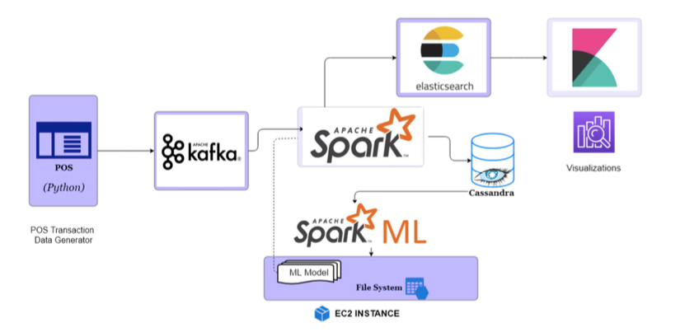
Architecture Diagram

Slide 6
Data Ingestion
Tools and Technologies:
Apache Kafka: High-throughput, low-latency platform for handling real-time data feeds
Apache Flume: Distributed service for efficiently collecting, aggregating, and moving large amounts of log data
Purpose:
Seamless data capture from multiple sources
Ensure data integrity and reliability

Slide 7
Stream Processing
Tools and Technologies:
Apache Storm: Real-time computation system for processing data streams
- Apache Spark Streaming: Scalable fault-tolerant stream processing system
Purpose:
Real-time data analysis
Detect anomalies and trigger alerts

Slide 8
Data Storage
Tools and Technologies:
HBase: Non-relational, distributed database designed to handle large amounts of sparse data
Cassandra: Highly scalable distributed database for managing large volumes of structured data
Purpose:
Store historical transaction data
Provide fast read and write capabilities

Slide 9
Analytics
Tools and Technologies:
Machine Learning Models: Classification algorithms (e.g., Random Forest, SVM)
Anomaly Detection Algorithms: Clustering, statistical models
Purpose:
Identify patterns indicative of fraud
Improve detection accuracy over time through model training

Slide 10
Visualization
Tools and Technologies:
Kibana: Data visualization plugin for Elasticsearch, providing real-time insights
Grafana: Open-source platform for monitoring and observability
Purpose:
Provide a visual interface for monitoring and analyzing fraud detection metrics
Enable quick decision-making

Slide 11
Challenges
Scalability: Handling increasing data volumes
Latency: Ensuring real-time processing without delays
Accuracy: Reducing false positives and negatives
Data Privacy: Protecting sensitive user information

Slide 12
Best Practices
Data Quality: Implement data validation and cleansing processes
Scalable Infrastructure: Use cloud-based solutions to manage load variations
Model Training: Regularly update and validate machine learning models
Security Measures: Employ robust encryption and access control mechanisms

Slide 13
Conclusion
Summary:
Effective real-time fraud detection relies on a robust big data architecture
Integration of various tools and technologies for seamless data flow
Continuous improvement through addressing challenges and adopting best practices

